Slide 1

PrEP Data Analysis and Reporting Tool (PrEP DART): A Privacy-Preserving Data Pipeline Incorporating Synthetic data for Public Health Analytics using Health Data Lab Frameworks
Master Thesis Proposal By
Gokul Thothathri
Under the Supervision Of Dr. Thilo Muth Dr. Daniel Schmidt Konstas Voulgaris

Slide 2
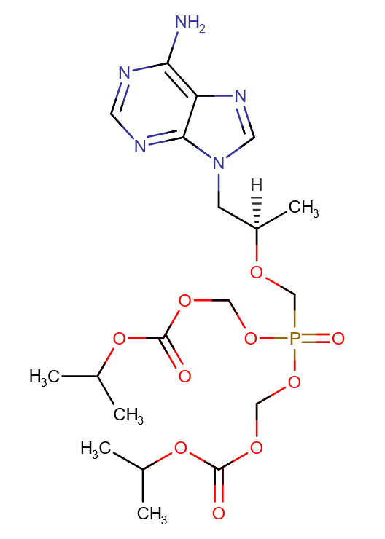
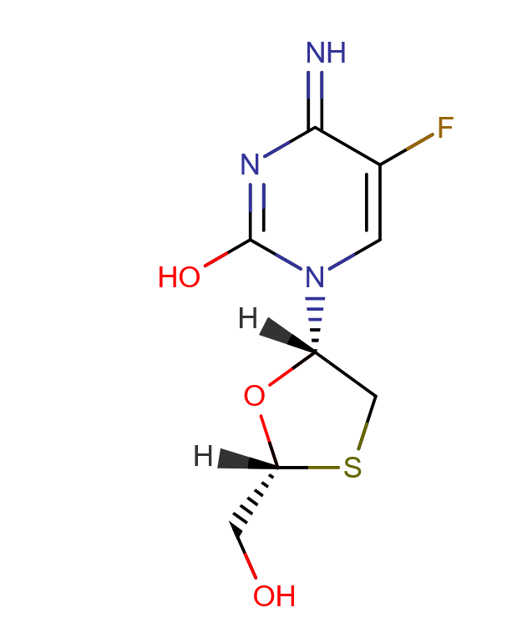
HIV PrEP Monitoring
Right to HIV pre-exposure prophylaxis (PrEP)
PrEP Surv (PrEP Surveillance): Established monitoring system for PrEP care, aligned with ECDC guidelines to ensure clinical efficacy.
Current frameworks (ECDC’s PrEP indicators) offer robust data structures but require manual data processing and lack real-time automation.
Key Challenges (1) Manual reporting requires significant time and resources, delaying timely insights.
(2) Lack of standarized pipelines for integrating and validating diverse health datasets.
+
Figure 1: Chemical Structure of TDF/FTC [1]
[1] DrugBank Online (accessed [23.01.2025])

Slide 3
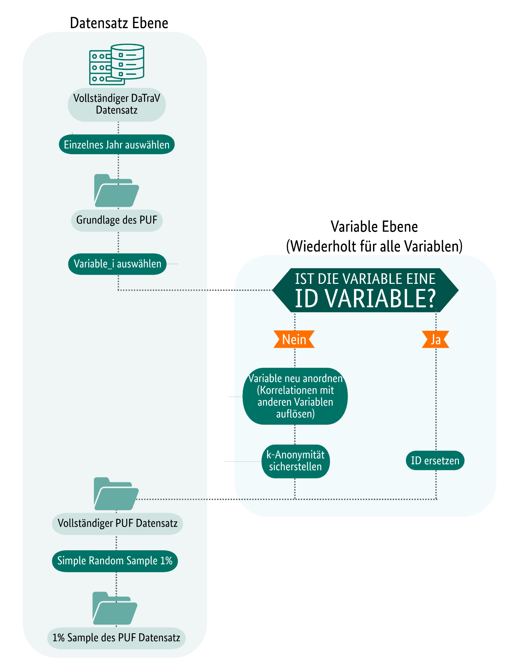
Methodology: Development of PrEP DART Pipeline
Data Collection: Use of Public Use Files (PUFs) from FDZ Gesundheit for synthetic data simulation.
Pipeline Development: Automate data cleaning, integration, and transformation using Python and FDZ frameworks.
Indicator Mapping: Map ECDC-defined indicators (e.g PrEP-to-Need-ratio) to anonymized datasets
Output Generation: Tabular summaries and visualizations using Python
Validation Testing: Test Pipeline accuracy with multiple versions of PUFs
Figure 2: PUF Data Generation

Slide 4
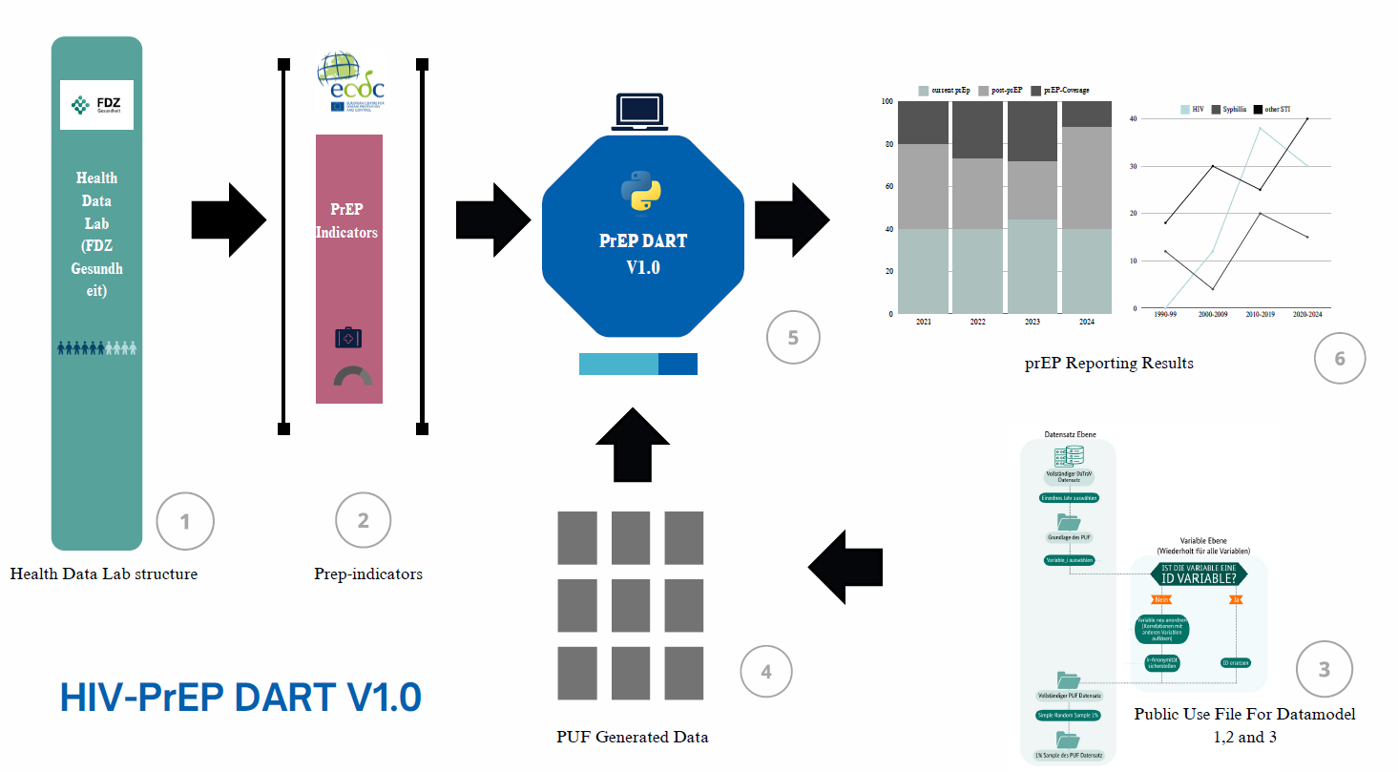
Methodology: PrEP DART Pipeline Architecture
Figure 3: PrEP-DART Architecture

Slide 5






Methodology: Expected Results and Deliverables
A fully functional pipeline (PrEP-DART) for automating indicator computation.
Comprehensive reports with metrics like: - PrEP coverage and uptake rates
- PrEP-to-Need Ratio (PnR) - Continuation and adherence rates
Visualizations for quarterly and annual trends in PrEP usage
Insights into gaps in PrEP program reach and effectiveness.
Validation Testing: Test Pipeline accuracy with multiple versions of PUFs Key Impact
(1) Supports data-driven decision-making for HIV prevention programs. (2) Establish a validation blueprint for scalable health data pipelines.
Figure 4: Technologies and Libraries

Slide 6

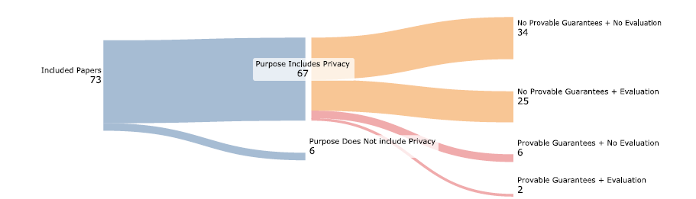
Literature Review
Collection of research papers for the review is based on whether the underlying study is “cross-sectional“ or “longitudinal“.
The metrics of performance are classified into key features
(1) Broad Utility (Statistical accuracy) (2) Narrow Utility (Used Cased Specified) (3) Fairness (Bias correction or fairness evaluation) (4) Privacy (Privacy preserving techniques, similarity based metrics) Most of the metrics are similarity based metrics for privacy evaluation
“Only 46% of studies claiming to employ synthetic privacy data for preserving privacy conducted privacy evaluation in these algorithms”
Kaabachi, Bayrem, et al. "A scoping review of privacy and utility metrics in medical synthetic data." NPJ digital medicine 8.1 (2025): 60.

Slide 7
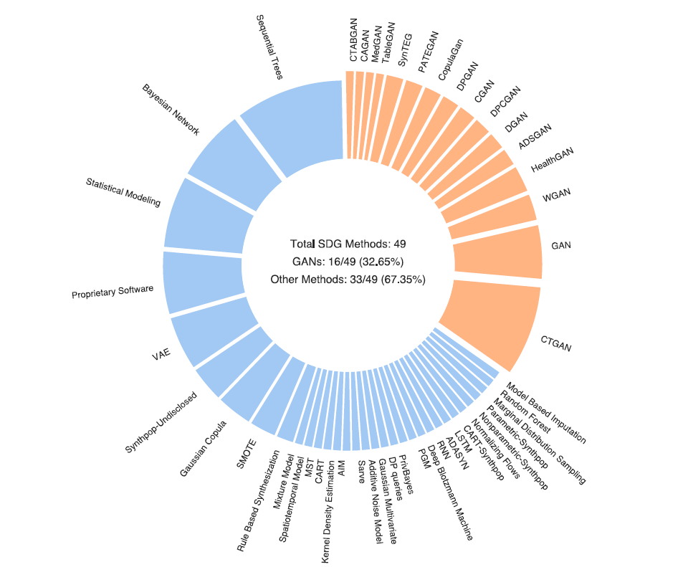
Literature Review
Nearly 32.65% Synthetic data generation methods in the underlying review are from Generative Adversial Models where the data is synthesized using feeding the models with true data. (You generate new CT images with with existing CT database)
The rest are statistical modeling, bayesian networks, propietary software. (constitutes 67.35%)
Kaabachi, Bayrem, et al. "A scoping review of privacy and utility metrics in medical synthetic data." NPJ digital medicine 8.1 (2025): 60.

Slide 8
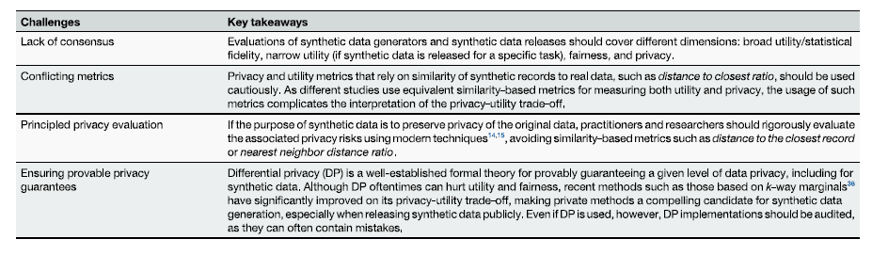
Literature Review
There exist a false sense of security bias that the practitioners may inadvertently assume that synthetic data they are generating is privacy preserving by default.
The review found that privacy aspect of synthetic data for the purpose of preserving privacy do not evaluate the residual privacy risk.
Kaabachi, Bayrem, et al. "A scoping review of privacy and utility metrics in medical synthetic data." NPJ digital medicine 8.1 (2025): 60.

Slide 9
PrEP DART focuses
Broad Utility:
PrEP-DART aims to be a scalable data analysis pipeline that automates data cleaning, integration, and reporting of public health indicators but the goal is not considered as “Broad Utility”.
Since it maps ECDC-defined indicators and follows an entity-relationship model, it prioritizes statistical accuracy and fidelity in public health analytics.
Narrow Utility:
The tool is specifically designed for monitoring HIV-PrEP indicators, which means it has narrow utility in the sense that its synthetic data is tailored for a specific task.
3. Fairness:
The proposal does not explicitly mention bias correction or fairness evaluation, but given that public health datasets often suffer from demographic biases, fairness considerations would be essential.
4. Privacy:
The PrEP-DART pipeline prioritizes privacy-preserving techniques, including anonymization, k-anonymity, and synthetic data generation.

Slide 10

Conclusion
"Traditional methods like k-Anonymity are insufficient against modern re-identification of health data”
Synthetic data generation itself is a form of anonymization technique.
Why do we need anonymization if the data is already anonymized ? General purpose anonymization algorithms may not be optimized for the HIR DART pipeline. The goal is to investigate whether better anonymization techniques ensures better results and usability

Slide 11
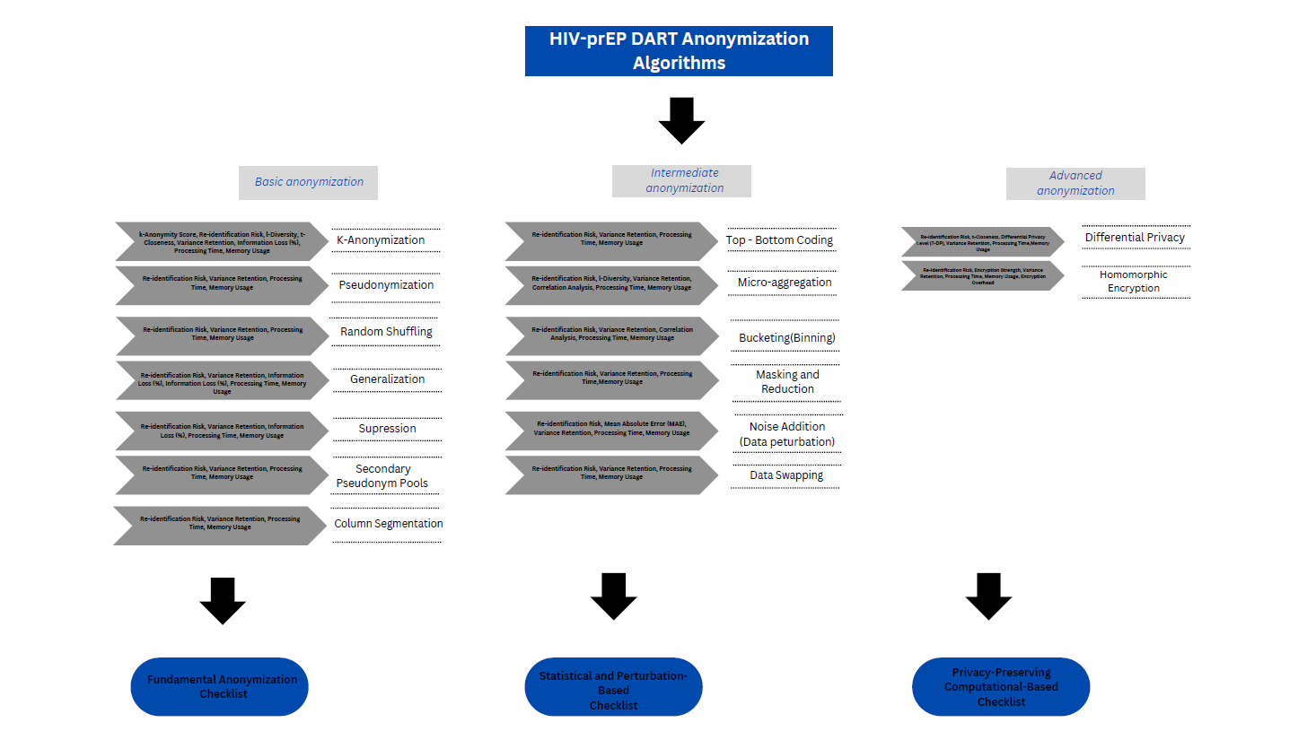
Methodology: Optimizing anonymization
Figure 5: Benchmarking anonymization algorithms

Slide 12
Expectations from Supervisors
Dr. Daniel Schmidt
A fully functional pipeline (PrEP-DART) for automating indicator computation.
Feedback on methodology design and validation process.
Support in interpreting key variables for public health application and how these variable interact with each other (Data definition).
Dr. Thilo Muth
Expertise in optimising workflow.
Architecture compliance.
Workflow management and feedback.
Weekly schedule to discuss about the technical aspects of PrEP-DART.
Konstas Voulgaris
Technical support for python-based analysis tools.
Database Support and Testing.

Slide 13
Conclusion: Next Steps
prEP DART aims to be a scalable blueprint for data validation and automate data reporting by generating synthetic data
To map the ECDC-defined PrEP indicators to the Health Data Lab dataset structure for computational calculation
Next Steps
Finalize pipeline architecture.
Begin indicator mapping and initial tests with mock datasets.
(3) Prepare for validation and final reporting.

Slide 14

Introduction to synthetic data

